Slide 1
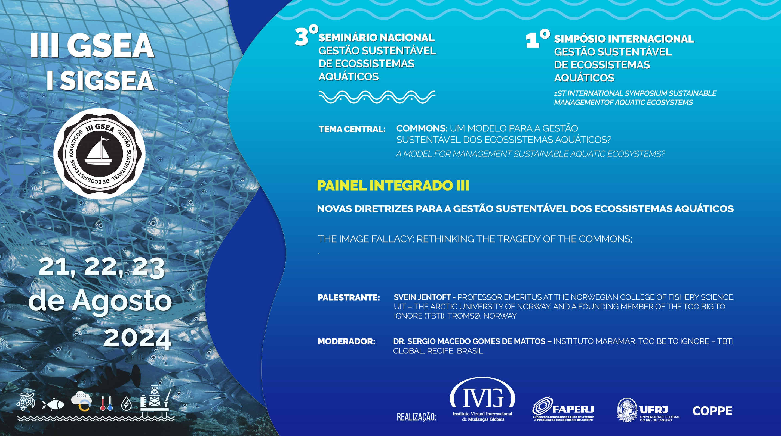

Slide 2

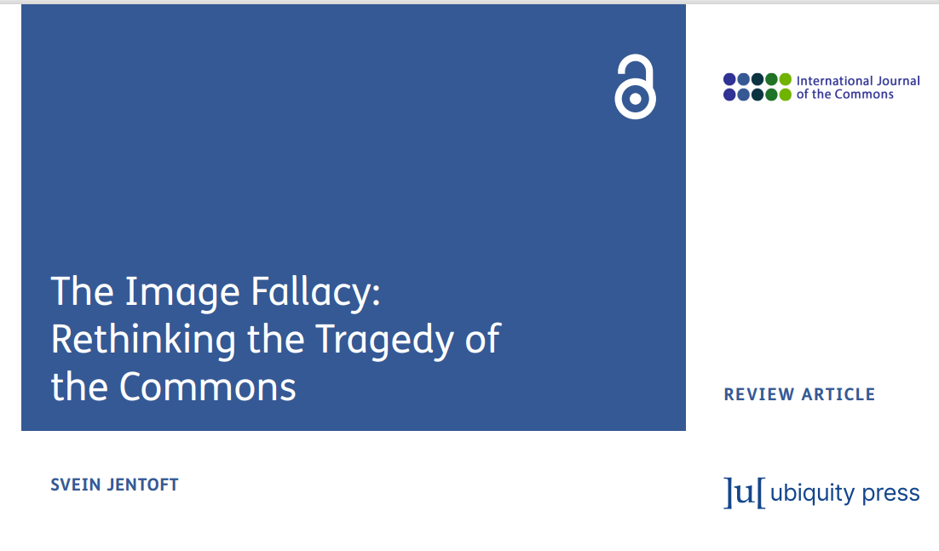

Slide 3
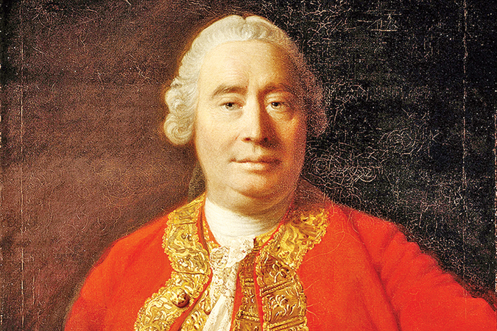
“Men are mightily govern'd by the imagination.”
David Hume (1711-1766)

Slide 4

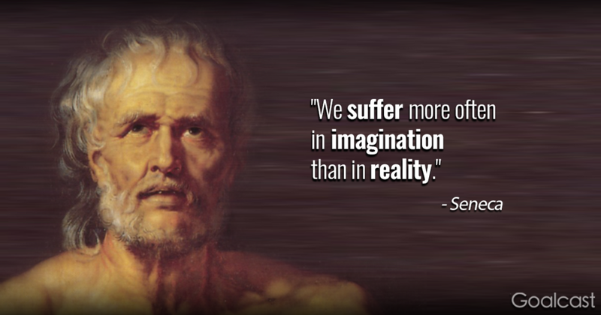

Slide 5
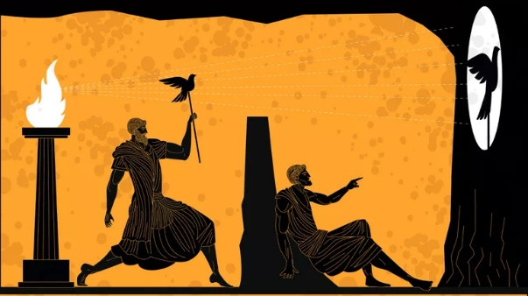
Plato (in The Republic):
The Allegory of the Cave

Slide 6
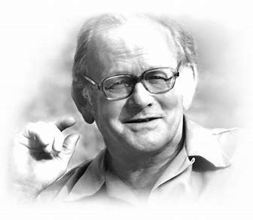
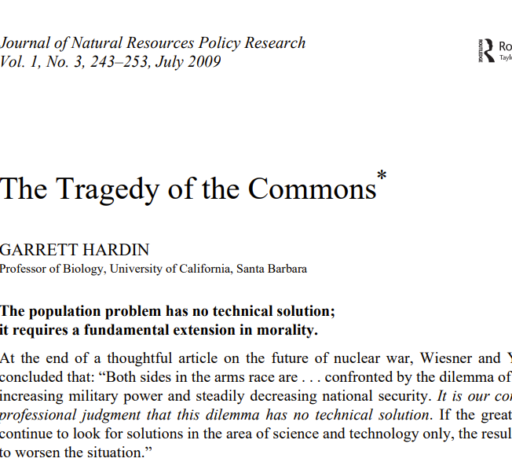
” The tragedy of the commons develops in this way. Picture a pasture open to all. It is to be expected that each herdsman will try to keep as many cattle as possible on the commons. Such….”

Slide 7
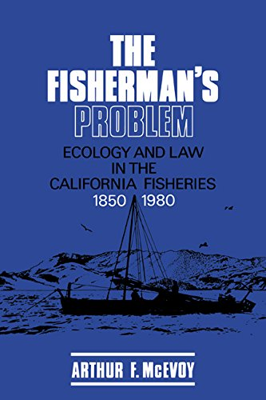

Slide 8
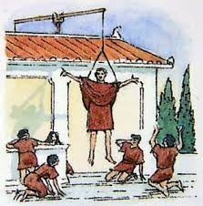
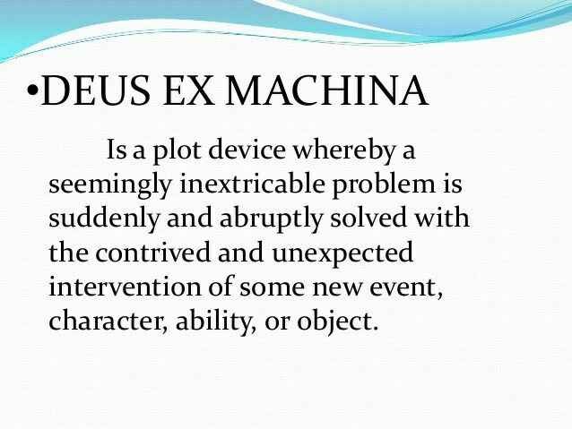

Slide 9
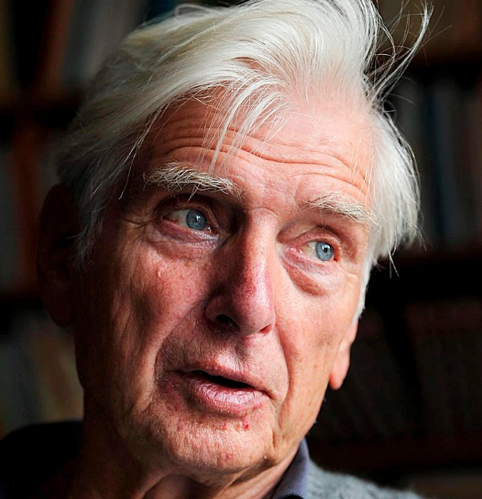
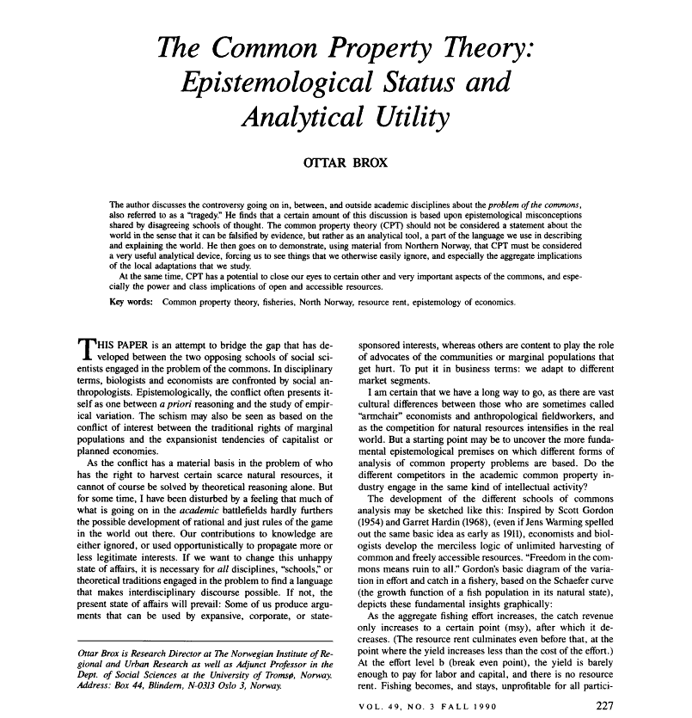

Slide 10
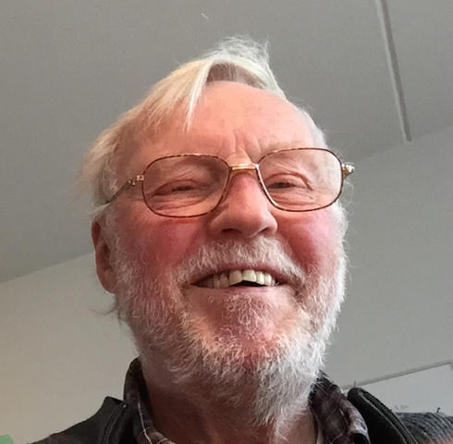
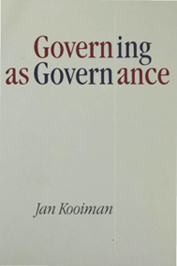
“Governing is inconceivable without the formation of images. Anyone involved in governing, in whatever capacity or authority, forms images about what he or she is governing.”

Slide 11
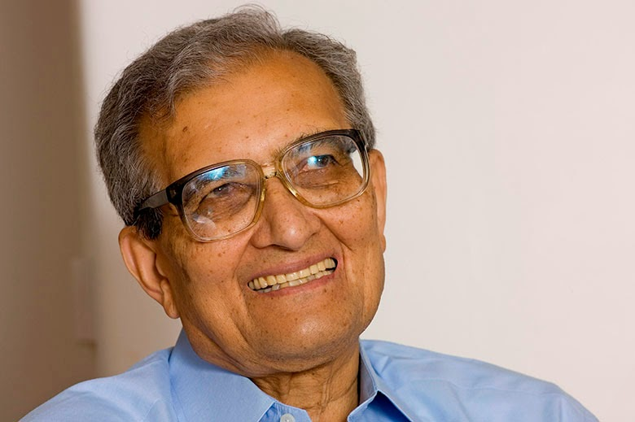
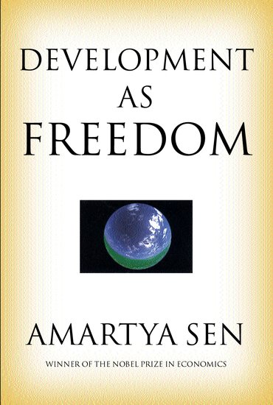
Amartya Sen on Freedom
“Freedoms are not only the primary ends of development, they are also among its principal means.”

Slide 12
The Four Archetypes of Literature
Tragedy
Romance
Comedy
Satire (Irony)

Slide 13
Closed system model
Open system model
Governance is a government responsibility
Gov. is exercised from the top down with stakeholders at the receiving end
Goals are developed at the central level
Little input from outside the management system
Emphasis on enforcement and
compliance
Gov. involves a complex, open, heterogeneous, and inherently unstable system
Unresolved conflict between more or less powerful stakeholders is a permanent feature
Goals are multiple, often inconsistent, and negotiated
Gov. is less about exercising authority than about political brokerage

Slide 14
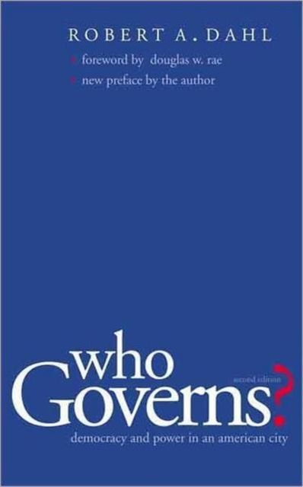
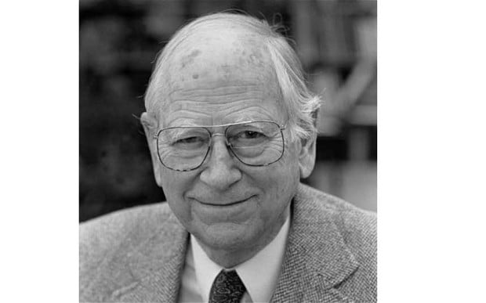

Slide 15
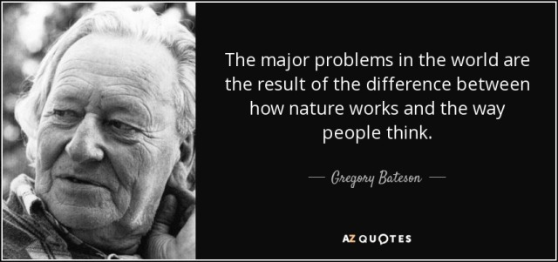

Slide 16

“The map is not the territory”
“The name is not the thing being named.”

Slide 17
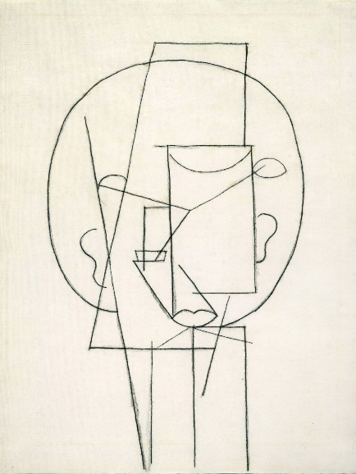
Picasso:
«Line-drawing of a man»
The image is not the thing being imaged

Slide 18
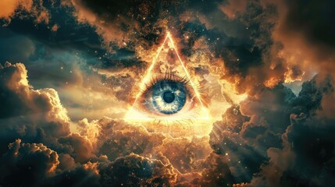

Slide 19
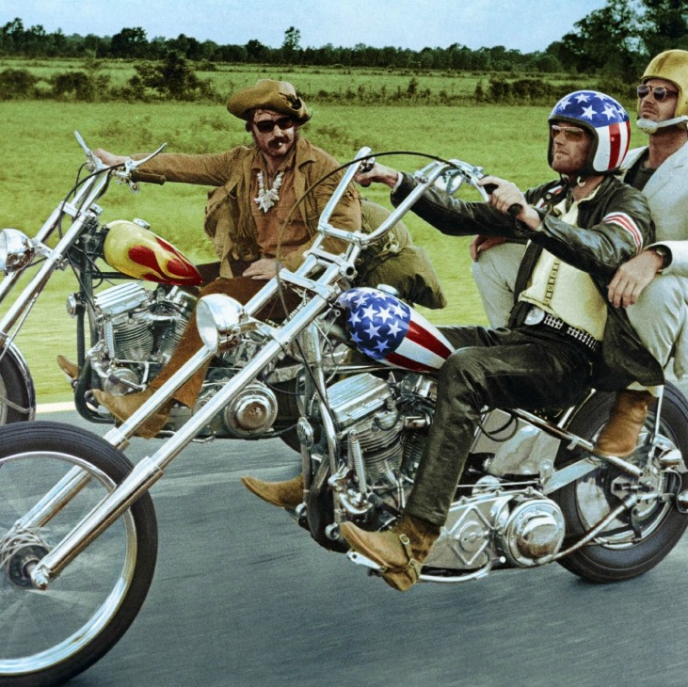
Peter Fonda:
I “I believe that one is only truly free when one is learning, and one can only learn when one is free.”

Slide 20

Thank you for listening!

